Slide 1
Scientific Computation and Data Visualization, Part 4
Link to this document
Applied Python

Slide 2
What are we doing?
Learning Objectives
By the end of this session, you should:
understand time series data.
identify different charts and their constituent features.
know how to effectively communicate information through vizualization.
Measurable Outcomes
By the end of this session, you should be able to:
convert string-formatted timestamps into datetime objects
given a dataset, select an appropriate chart.
modify properties of different charts.

Slide 3
TIMESTAMPS

Slide 4
Timestamps: date (and time)
At some point in your programming life, you're going to encounter datasets which are clearly time series data. Manipulating this data can yield very useful information - but in order to do so, you're going to need to know how to work with it!
Python provides a package called datetime which allows for a new datatype - the datetime object - which will hold this type of data.
Pandas expands on it, allowing for an entire Series to be of type datetime.

Slide 5
datetime: as a Series
And it turns out that, even if the data aren't detected as a datetime object when imported, you can convert an existing String data into a datetime object via pd.to_datetime().
To contextualize this immediately, you're going to use the Global Temperature Anomaly dataset from NOAA - specifically, 126 years of data from 1880 to 2005. The source can be found here.
Coding Challenge:
Write a program which will wrangle the Global Temperature Anomaly dataset's Year column into a datetime Series.

Slide 6
Coding challenge: solution
The plan:
import the data
extract date column
convert date column to datetime object
re-insert the date column into the dataframe
import pandas as pd
def main():
# import the data
file_path = 'global_temp_anomaly_1880-2005.csv'
df_temp_anom = pd.read_csv(file_path, skiprows=3)
# extract, convert, and re-insert
df_temp_anom['Year'] = pd.to_datetime(df_temp_anom['Year'], format='%Y')
if __name__ == '__main__':
main()

Slide 7
datetime: individual parts
You can see now that the entire Year Series has been converted into datetime objects! (These objects must always have at least year, month, and day; hour, minute, section, and milli/micro/nano -second are optional.)
Now that you have these datetime objects, you should know how to extract data from them. It's as simple as accessing the object attributes.
# ... previous code goes here
def main():
# ... previous code goes here
# access the year
df['actual year'] = df['Year'].dt.year
# access the month (not useful in this example, but still)!
df['month'] = df['Year'].dt.month
# combine attrs (not useful in this example, but still)!
df['month-day'] = df['Year'].dt.strftime("%m-%d")
if __name__ == '__main__':
main()

Slide 8
datetime: move to the index
Given that you've now learned how to convert a String timestamp Series to a datetime Series - and given that what that means about the data itself is that it's either Time Series or Panel data - it would make sense to move the timestamps into the index of the DataFrame; the DataFrame would then actually have meaningful indexes. This can be done easily with the .set_index() method.
# ... previous code goes here
def main():
# ... previous code goes here
# change indexes and remove redundant column
df_temp_anom = df_temp_anom.set_index('Year')
if __name__ == '__main__':
main()

Slide 9
datetime indexes: retrieval
Remember that what you're trying to accomplish here is make your life easier when manipulating datasets. So now that you've got the datetime objects converted and set as the index, how do you use them?
Easy peasy: you can index datetime objects via an equivalent String! Thank you, pandas!
from datetime import datetime
def main():
# ... previous code goes here
# select, slice, and loc/iloc
print(df_temp_anom.loc['1900'])
print(df_temp_anom['1900':'1920'])
print(df_temp_anom.iloc[:10, :])
print(df_temp_anom.loc['1900', :])
if __name__ == '__main__':
main()

Slide 10
SMOOTHING

Slide 11
Global temperature anomaly
Before you learn about smoothing, let's get some visualizations going. Use the same data as before - the Global Temperature Anomaly dataset.
Coding Challenge:
Visualize the raw data in a line plot, making sure that the dates are:
in datetime format
the DataFrame's indices

Slide 12
Coding challenge: solution
The plan:
import the data
extract date column
convert date column to datetime object
re-insert the date column into the dataframe
replace indexes with datetime column and drop datetime column
plot data
import pandas as pd
import matplotlib.pyplot as plt
def main():
# import the data
file_path = 'global_temp_anomaly_1880-2005.csv'
df_temp_anom = pd.read_csv(file_path, skiprows=5)
# extract, convert, re-insert, and change indexes
df_temp_anom['Year'] = pd.to_datetime(df_temp_anom['Year'], format='%Y')
df_temp_anom = df_temp_anom.set_index(df_temp_anom['Year'])
# plot
fig, ax = plt.subplots(1, 1)
ax.plot(df_temp_anom.index, df_temp_anom, alpha=0.5)
ax.tick_params(axis='x', rotation=90)
# save the image
fig.savefig('Global Temperature Anomaly Visualization.png')
if __name__ == '__main__':
main()

Slide 13
Smoothing
Sometimes you'll want to visualize data such that you can see every single detail in the dataset itself. But there will be other times when it makes sense to visualize longer-term trends rather than every minute detail. In these instances, one of the tools you can employ is smoothing. Smoothing is a technique which will average out data across a particular time period.

Slide 14
Rolling
In order to smooth your data, you'll first need to define how you're going to smooth it. A rolling window will group the n neighbor records. These may be before, on either side, or after the original record. From there, you can aggregate each rolling window group into one record. Plotting the resulting data gives you a smoothed out version of the original dataset!

Slide 15
Coding challenge: smoothing
Coding Challenge:
Smooth the data and visualize it so that you can see the longer-term trends. Use 10 years as the rolling window (.rolling()) size.

Slide 16
Coding challenge: solution
The plan:
import the data
extract date column
convert date column to datetime object
re-insert the date column into the dataframe
replace indexes with datetime column and drop datetime column
plot raw data
create rolling windows and aggregate them
plot smoothed data
import pandas as pd
import matplotlib.pyplot as plt
def main():
# import the data
file_path = 'global_temp_anomaly_1880-2005.csv'
df_temp_anom = pd.read_csv(file_path, skiprows=5)
# extract, convert, re-insert, and change indexes
df_temp_anom['Year'] = pd.to_datetime(df_temp_anom['Year'], format='%Y')
df_temp_anom = df_temp_anom.set_index(df_temp_anom['Year'])
# plot
fig, ax = plt.subplots(1, 1)
ax.plot(df_temp_anom.index, df_temp_anom, alpha=0.5, label='raw')
ax.plot(df_temp_anom.rolling(20).mean(), label='smoothed')
ax.tick_params(axis='x', rotation=90)
ax.legend()
# save the image
fig.savefig('Global Temperature Anomaly Visualization.png')
if __name__ == '__main__':
main()

Slide 17
REVISITING VISUALIZATIONS

Slide 18
Pretty pictures
Earlier in the semester, it was mentioned that matplotlib can visualize data in a number of ways, including but not limited to:
line: .plot()
scatter: .scatter()
bar: .bar()
pie: .pie()
histogram: .hist()
Let's explore each of these (and a couple others) just a little more.

Slide 19
Coding Challenge
Plot the following data as line plots in one Axes in one Figure in matplotlib:
years = [2016, 2017, 2018, 2019, 2020]
enrollment_TAC_115 = [180, 250, 390, 540, 720]
enrollment_TAC_449 = [70, 150, 130, 180, 220]
Make sure to add to the figure:
title
axis labels
a legend

Slide 20
Coding Challenge: solution
The plan:
import matplotlib
plot the 115 data
plot the 449 data (in the same area)
add identifying attributes:
label the axes
add a title
add a legend
save the figure
import matplotlib.pyplot as plt
def main():
years = [2016, 2017, 2018, 2019, 2020]
enrollment_TAC_115 = [180, 250, 390, 540, 720]
enrollment_TAC_449 = [70, 150, 130, 180, 220]
# create the plotting area and plot the data
fig, ax = plt.subplots(1, 1)
ax.plot(years, enrollment_TAC_115, label='TAC 115')
ax.plot(years, enrollment_TAC_449, label='TAC 449')
# add identifying attributes
ax.set(xlabel='Year', ylabel='Enrollment', title='TAC enrollments 2016 to 2020')
ax.legend()
# save the figure
fig.savefig('TAC enrollments - line plot.png')
if __name__ == '__main__':
main()

Slide 21
matplotlib: line formatting
There are many many ways to modify the look of the data you plot. Options are passed as keyword arguments to the plotting method. Options include but are not limited to:
alpha: opacity (0 to 1, default 1)
color: color names, letters, or even hex code (default chosen by pyplot, used by legend)
label: how to refer to the data in the plot itself (used by the legend)
linestyle: solid line, dash, et al. (String, default '-', used by legend
marker: shape of the marker at each point (String, default '.', used by legend)
# ... previous code goes here
def main():
# ... previous code goes here
ax.plot(x, y, linestyle='--', color='g')
# ... previous code goes here
if __name__ == '__main__':
main()

Slide 22
Plotting: a note on ticks
Matplotlib automatically determines the range for each axis and sets the ticks accordingly. But occasionally, you will want to readjust either the locations of tick labels, or what those labels say, or both. This can be done via:
Locations: Axes.xaxis.set_ticks() and Axes.yaxis.set_ticks()
Values: Axes.xaxis.set_ticklabels() and Axes.yaxis.set_ticklabels()
Note that these need to agree in length - so if you decide that you want 100 ticks, you will need to provide 100 labels!
# ... previous code goes here
def main():
# ... previous code goes here
ax.xaxis.set_ticks(years)
the_future = [year*1000 for year in years]
ax.xaxis.set_ticklabels(the_future)
# ... previous code goes here
if __name__ == '__main__':
main()

Slide 23
Coding Challenge
Given what you now know about line plots, plot the following data as scatter plots in one Axes in one Figure in matplotlib:
years = [2016, 2017, 2018, 2019, 2020]
enrollment_TAC_115 = [180, 250, 390, 540, 720]
enrollment_TAC_449 = [70, 150, 130, 180, 220]
Make sure to add to the figure:
title
axis labels
a legend

Slide 24
Coding Challenge: solution
The plan:
import matplotlib
scatter plot the 115 data
scatter plot the 449 data (in the same area)
add identifying attributes:
label the axes
add a title
add a legend
save the figure
import matplotlib.pyplot as plt
def main():
years = [2016, 2017, 2018, 2019, 2020]
enrollment_TAC_115 = [180, 250, 390, 540, 720]
enrollment_TAC_449 = [70, 150, 130, 180, 220]
# create the plotting area and plot the data
fig, ax = plt.subplots(1, 1)
ax.scatter(years, enrollment_TAC_115, label='TAC 115')
ax.scatter(years, enrollment_TAC_449, label='TAC 449')
# add identifying attributes
ax.set(xlabel='Year', ylabel='Enrollment', title='TAC enrollments 2016 to 2020')
ax.legend()
# save the figure
fig.savefig('TAC enrollments - scatter plot.png')
if __name__ == '__main__':
main()

Slide 25
matplotlib: scatter plot formatting
There are many many ways to modify the look of the data you plot. Options are passed as keyword arguments to the plotting method. Options for scatterplots include but are not limited to:
alpha: opacity (0 to 1, default 1)
color: color names, letters, or even hex code (default chosen by pyplot)
label: how to refer to the data in the plot itself (used by the legend)
marker: shape of the marker at each point (String, default 'o')
# ... previous code goes here
def main():
# ... previous code goes here
ax.scatter(x, y, marker='*', color='#0000ff')
# ... previous code goes here
if __name__ == '__main__':
main()

Slide 26
Coding Challenge
Given what you know about line and scatter plots, plot the following data as bar plots in one Figure in matplotlib:
years = [2016, 2017, 2018, 2019, 2020]
enrollment_TAC_115 = [180, 250, 390, 540, 720]
enrollment_TAC_449 = [70, 150, 130, 180, 220]
Make sure to add to the figure:
title
axis labels
a legend

Slide 27
Coding Challenge: solution
The plan:
import matplotlib
bar plot the 115 data
bar plot the 449 data (in the same area)
add identifying attributes:
label the axes
add a title
add a legend
save the figure
import matplotlib.pyplot as plt
def main():
years = [2016, 2017, 2018, 2019, 2020]
enrollment_TAC_115 = [180, 250, 390, 540, 720]
enrollment_TAC_449 = [70, 150, 130, 180, 220]
# create the plotting area and plot the data
fig, ax = plt.subplots(1, 1)
ax.bar(years, enrollment_TAC_115, label='TAC 115')
ax.bar(years, enrollment_TAC_449, label='TAC 449')
# add identifying attributes
ax.set(xlabel='Year', ylabel='Enrollment', title='TAC enrollments 2016 to 2020')
ax.legend()
# save the figure
fig.savefig('TAC enrollments - bar plot.png')
if __name__ == '__main__':
main()

Slide 28
matplotlib: bar plot formatting
There are many many ways to modify the look of the data you plot. Options are passed as keyword arguments to the plotting method. Options for bar plots include but are not limited to:
alpha: opacity (0 to 1, default 1)
color: color names, letters, or even hex code (default chosen by pyplot)
label: how to refer to the data in the plot itself (used by the legend)
width: width of the bar (0 to 1, default 1)
# ... previous code goes here
def main():
# ... previous code goes here
ax.bar(years, enrollment, width=0.5)
# ... previous code goes here
if __name__ == '__main__':
main()

Slide 29
Layering: an observation
What happens if you bar plot the 449 data before the 115 data?
What can be done about that?

Slide 30
Coding Challenge
Given what you know now about pyplot, plot the following data as a pie plot in one Figure in matplotlib:
# browser market share as of 2022 Dec
# https://gs.statcounter.com/browser-market-share#monthly-200901-202212
browsers = ['Chrome', 'Safari', 'Edge', 'Samsung Internet', 'Firefox', 'Opera']
percentage = [64.68, 18.29, 4.23, 3.05, 3.01, 2.25]
Make sure to add to the figure:
title
a legend

Slide 31
Coding Challenge: solution
The plan:
import matplotlib
pie plot percentages
add browsers as labels on data
add identifying attributes:
add a title
add a legend
save the figure
import matplotlib.pyplot as plt
def main():
browsers = ['Chrome', 'Safari', 'Edge', 'Samsung Internet', 'Firefox', 'Opera']
percentages = [64.68, 18.29, 4.23, 3.05, 3.01, 2.25]
# create the plotting area and plot the data
fig, ax = plt.subplots(1, 1)
ax.pie(percentages, labels=browsers,
autopct='%.2f', explode=[0,.1,.3,.4,.6,.5],
startangle=55)
# add identifying attributes
ax.set(title='Browser market share 2022.12')
ax.legend()
# save the figure
fig.savefig('Browser market share 2022.12.png')
if __name__ == '__main__':
main()

Slide 32
matplotlib: pie plot formatting
There are many many ways to modify the look of the data you plot. Options are passed as keyword arguments to the plotting method. Options for pie plots include but are not limited to:
autopct: percentage label formatting
explode: how far away from the center to plot the slice
labels: how to refer to the data in the plot itself (used by the legend)
startangle: where to begin plotting the slices of the pie
import matplotlib.pyplot as plt
def main():
# ... previous code goes here
ax.pie(percentages, labels=browsers, autopct='%.2f', explode=[0,.2,.4,.6,.8,1])
# ... previous code goes here
if __name__ == '__main__':
main()

Slide 33
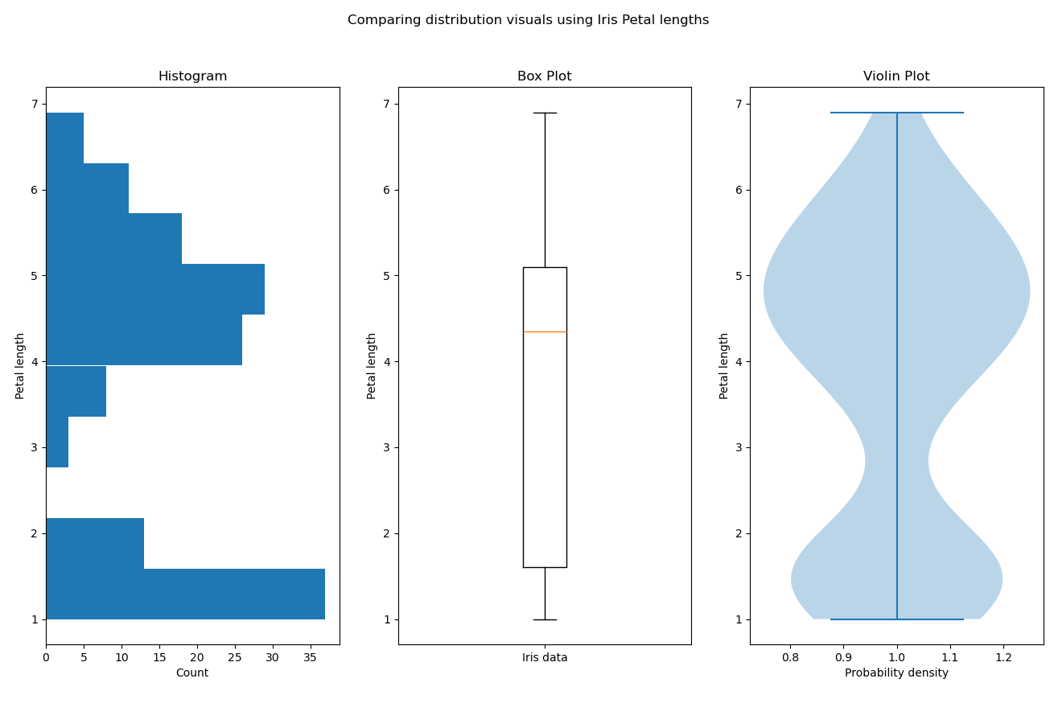
Visuals: three more kinds
There are three other visualization types that you may encounter - all of which deal with probability distributions. You are absolutely allowed to use these in this course:
Histogram
Box Plot
Violin Plot

Slide 34
Summary of terms
Terminology:
Smoothing
Rolling window
visualization options
specific terminology/syntax:
datetime module
pandas.to_datetime()
DataFrame.set_index()
DataFrame.rolling()
.plot() options
.scatter() options
.bar() options
.pie() options
.hist() options

